Slide 1
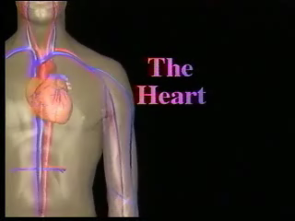
LECTURE NO (4)
CVS Physiology Bader Hassan
Lecturer Of Physiology
Cardiac output
COP
Faculty Of Medicine Dept.Of Physiology

Slide 2
The cardiac output
Is the volume of blood ejected by each ventricle each minute.
It equal 5 L/min in an average adult male at rest , less in females.

Slide 3
Control of the COP
COP = HR X SV
Its controlled by controlling: heart rate & stroke volume.
Control of the heart rate:-
Normal heart rate ranges between 60-100 beats/min.
Less than 60= bradycardia.
More than 100 = tachycardia.

Slide 4
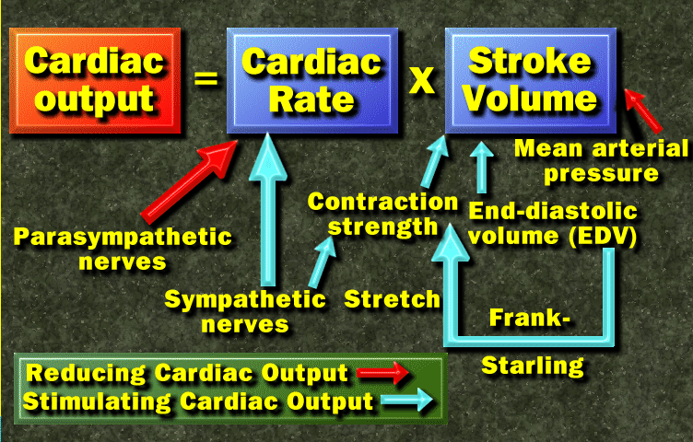

Slide 5
Factors affecting the HR
Neural factors :-
HR is increased by sympathetic & decreased parasympathetic.
Hormonal factors:-
HR is increased by catecholamines & thyroid hormones.
Physiological factors:-
HR is increased by exercise and decreased by sleep.

Slide 6
Physical factors:-
HR is increased by high temperature & decreased by cold.
Drugs:-
HR is increased by atropine (muscarinic blocker)
HR is decreased by propranolol.

Slide 7
Control of stroke volume (SV)
Volume of blood ejected by each ventricle each beat.
Equal 70 ml in an average adult male at rest.
Factors affecting the SV are:-
SV is ↑ by sympathetic stimulation.
Parasympathetic has no direct effect on the stroke volume because it does not supply the ventricle.

Slide 8
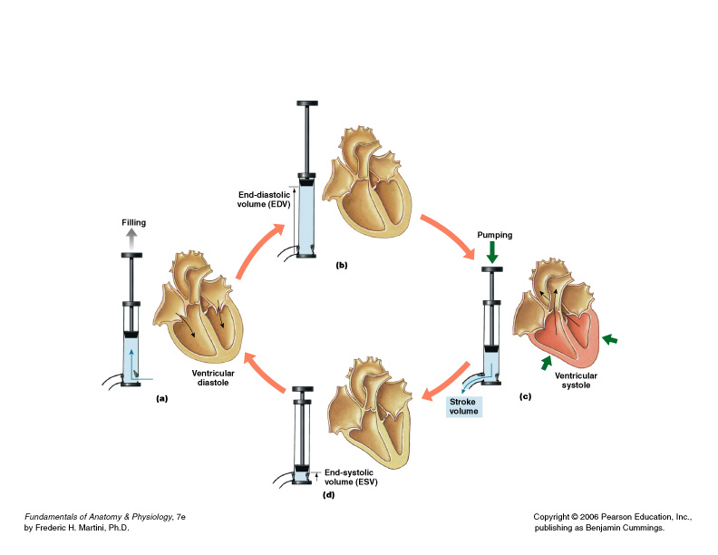
Stroke Volume
Volume (ml) of blood ejected per beat
Figure 20–19

Slide 9
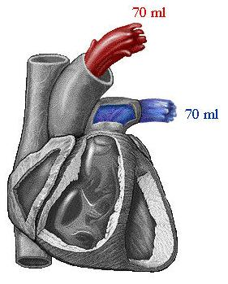

Slide 10
Hormonal factors :-
SV ↑ by catecholamines & thyroid hormones.
Physiological factors:-
SV is ↑ by exercise.
Physical factors:-
SV is ↑ by high temperature and ↓ by cold .
Drugs :-
SV ↑ is by digitalis & ↓ by beta blockers.

Slide 11
Ions :-
SV is ↑ by calcium ions
Hypercalcemia can stops the heart in systolic phase.

Slide 12
Preload & after load
Preload : the load on the ventricle before contraction.
Means the end diastolic volume which depend on venous return.
When the preload is ↑ the SV is ↑ according to the Frank – Starling law.

Slide 13
Frank – Starling law
Describe a direct relationship between the force of contraction and the initial length of the ventricular muscle fibers before contraction.
The initial length of the ventricular muscle fibers depend on the end diastolic volume (the venous return).

Slide 14
After load
Is the resistance in arteries against ejection of blood.
When increased it decreases the stroke volume.
After load is increased by stenosis of aortic valve and hypertension.

Slide 16
(لا إله إلا أنت سبحانك إني كنت من الظالمين)

